Slide 1




MOOE
ELIGIBLE EXPENSES, CHECKLIST & SUPPORTING DOCUMENTS

Slide 2
DEPED ORDER NO.8 S. 2019
USES OF SCHOOL MOOE
School MOOE, as defined under the Definition of Terms per Section IV. of this DO, shall also be used for the following, among others, subject to availability of funds and prioritization of mandatory expense items; and must be in accordance with the existing budgeting, accounting, procurement and auditing rules and regulations.
1.To fund activities as identified in the approved School Improvement Plan (SIP) for the implementation in the current year as specifically determined in the Annual Implementation Plan (AIP) which shall follow the calendar year format (Annex1) of the school:

Slide 3
DEPED ORDER NO.8 S. 2019
USES OF SCHOOL MOOE
2. To finance expenses pertaining to graduation rites, moving up or closing ceremonies and recognition activities;
3. To fund supplies, rental and minor repair of tools and equipment and other consumables for teachers and students deemed necessary in the conduct of classes and learning activities;

Slide 4
DEPED ORDER NO.8 S. 2019
USES OF SCHOOL MOOE
4) To fund minor repairs facilities, building and grounds maintenance necessary for the upkeep of the school (as defined in DepEd Order No.1, s.2017 entitled Guidelines on the National Inventory of DepEd Public School Building for the School Year 2016-2017);
5) To procure semi-expendable property items worth less than Php 50,000.00 (including Technical-Vocational-Livelihood and Science classes consumables) as provided in the Government Accounting Manual (GAM) issued by the Commission on Audit;

Slide 5
DEPED ORDER NO.8 S. 2019
USES OF SCHOOL MOOE
6) In no case shall the school MOOE be used for the procurement of:
9.1. School seats and teacher's tables and chairs except for school furniture which are not procured/provided by the Central, Regional or School Division Officers. These may include laboratory and workshop furniture;
9.2 Textbooks; and
9.3 Other supplementary learning resources (SLRs) which include publications, periodicals and review materials

Slide 6
MOOE ELIGIBLE EXPENSES
SEMI-EXPENDABLE OFFICE EQUIPMENT EXPENSES (5020321002)
This account is used to recognize the cost/fair value of purchased/acquired office equipment costing less than 50,000 for the use of government operations.
stapler
puncher
calculator
scissors
hard drive, USB, blank cd
staple wire remover
DLP, projector screen
ID laminator
paper cutter
biometrics
steel cabinet
drawer
bell/buzzer
monobloc table & chairs

Slide 7
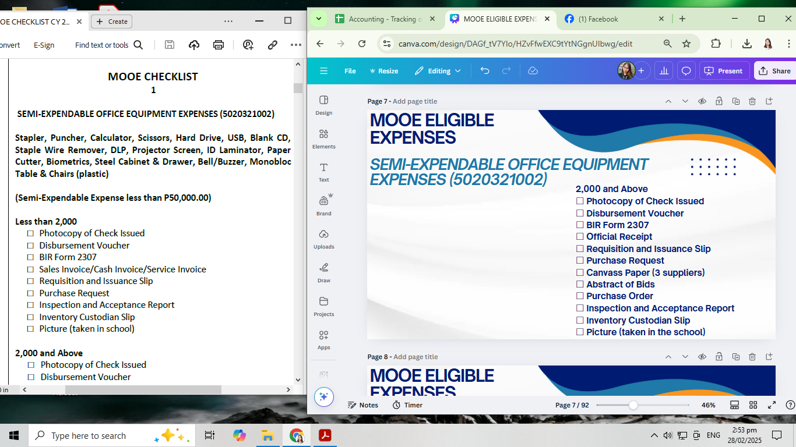
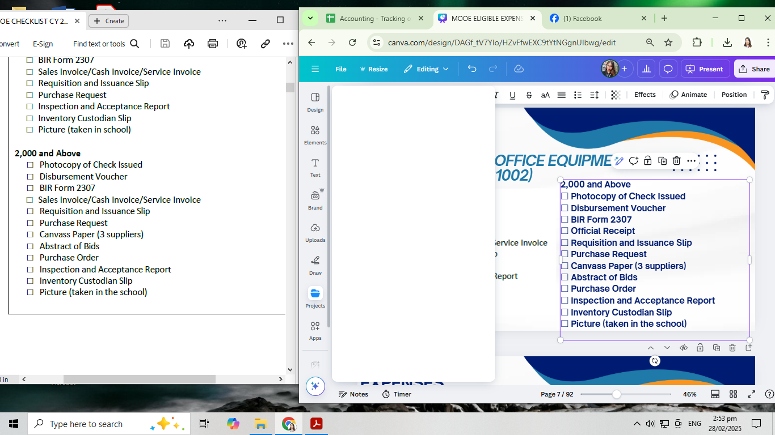
MOOE ELIGIBLE EXPENSES
SEMI-EXPENDABLE OFFICE EQUIPMENT EXPENSES (5020321002)

Slide 8
MOOE ELIGIBLE EXPENSES
SEMI-EXPENDABLE INFORMATION AND COMMUNICATIONS TECHNOLOGY EQUIPMENT EXPENSES (5020321003)
This account is used to recognize the cost/fair value of the purchased/acquired information and communications technology equipment
desktop computer
DLP projector
laptops
printers & scanners
internet modem/pocket WIFI
CCTV and the like, costing less than 50,000 for the use in government operations.

Slide 9
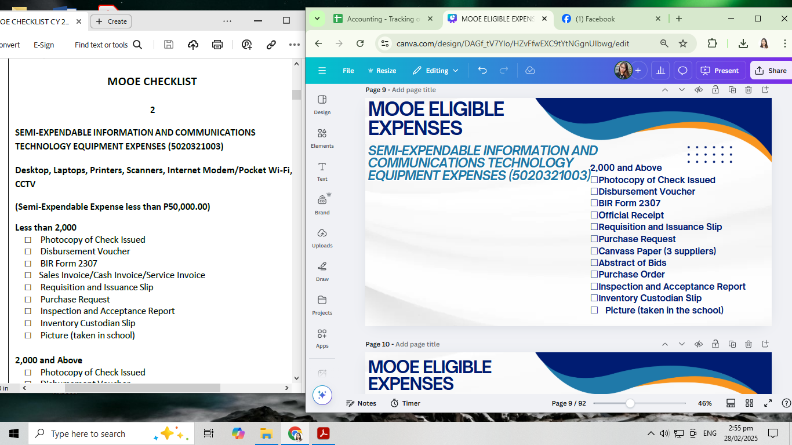
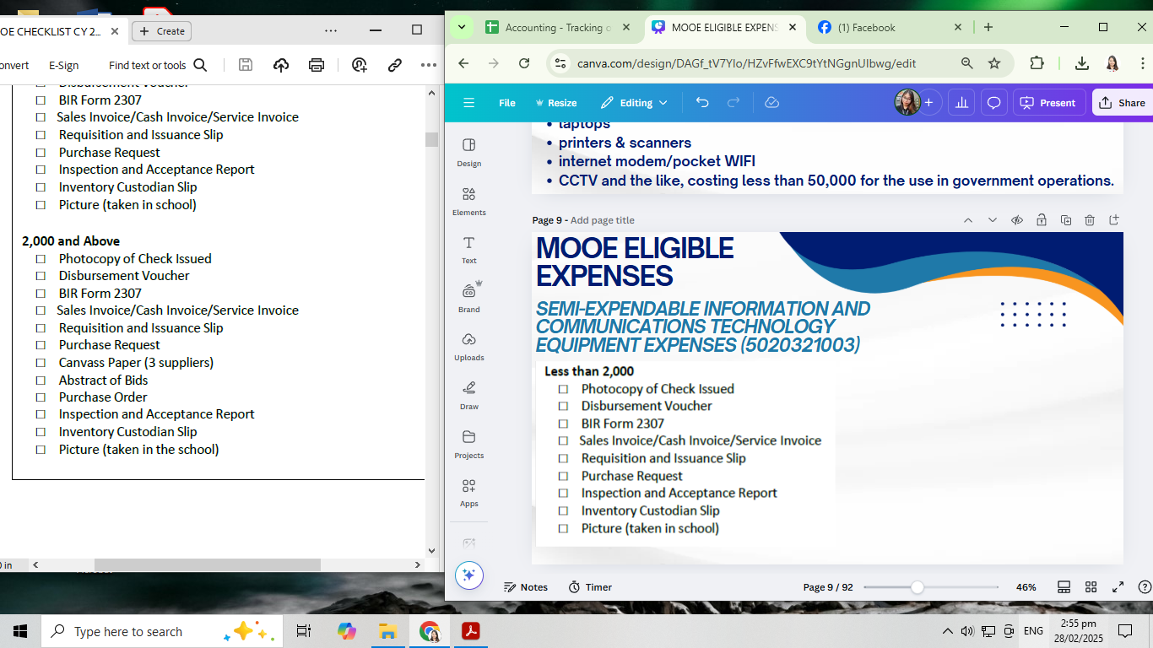
MOOE ELIGIBLE EXPENSES
SEMI-EXPENDABLE INFORMATION AND COMMUNICATIONS TECHNOLOGY
EQUIPMENT EXPENSES (5020321003)

Slide 10
MOOE ELIGIBLE EXPENSES
SEMI-EXPENDABLE AGRICULTURAL AND
FORESTRY EQUIPMENT EXPENSES (5020321004)
This account is used to recognize the cost/fair value of the purchased or acquired agricultural and forestry equipment costing less than 50,000.
threshing and milling machines
plow
grass cutting machines
farming
gardening tools.

Slide 11
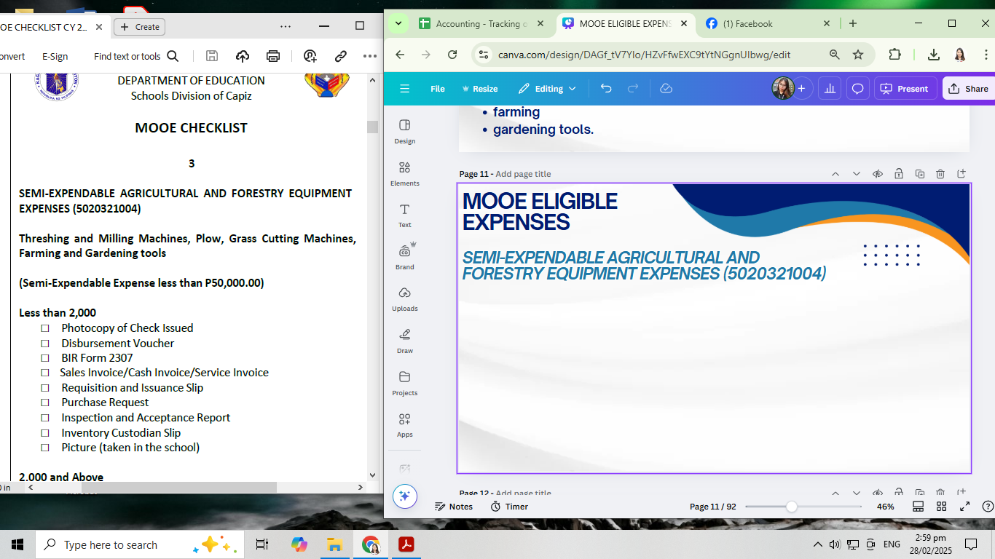
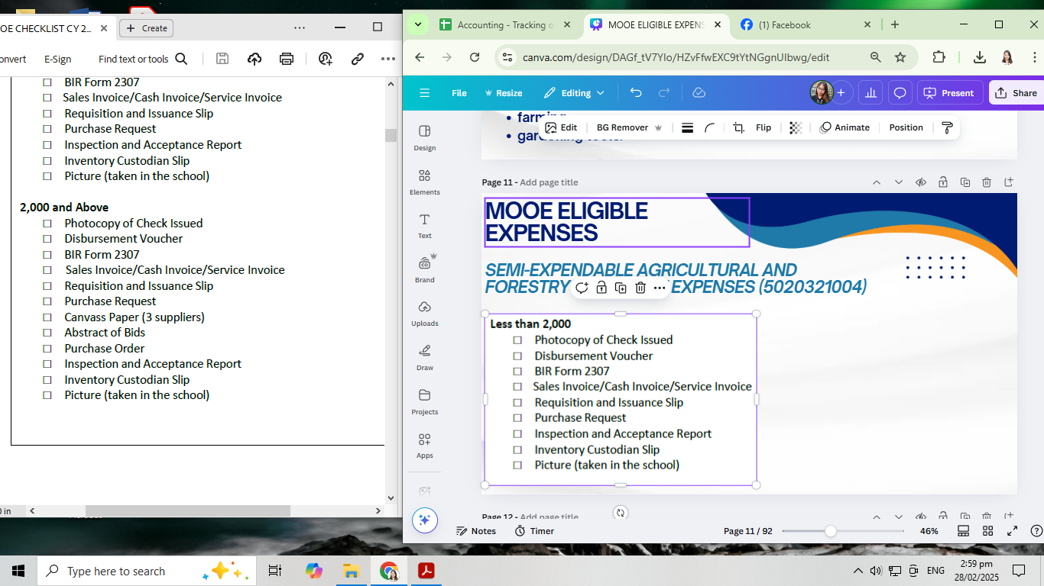
MOOE ELIGIBLE EXPENSES
SEMI-EXPENDABLE AGRICULTURAL AND
FORESTRY EQUIPMENT EXPENSES (5020321004)

Slide 12
MOOE ELIGIBLE EXPENSES
SEMI-EXPENDABLE COMMUNICATION
EQUIPMENT EXPENSES (5020321007)
This account is used to recognize the cost/fair value of the purchased /acquired communication equipment costing less than 50,000 for the use in the government operations
It includes two-way radio (walkie-talkie) and the like for the use in government operations.

Slide 13
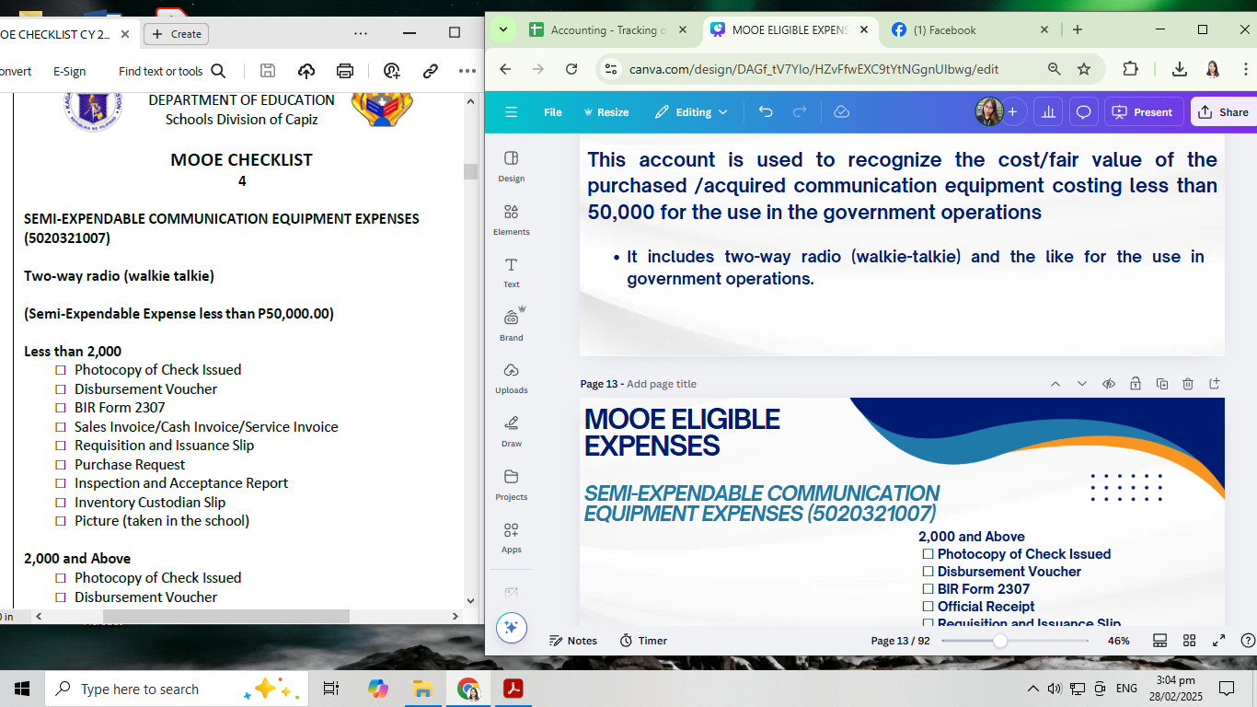
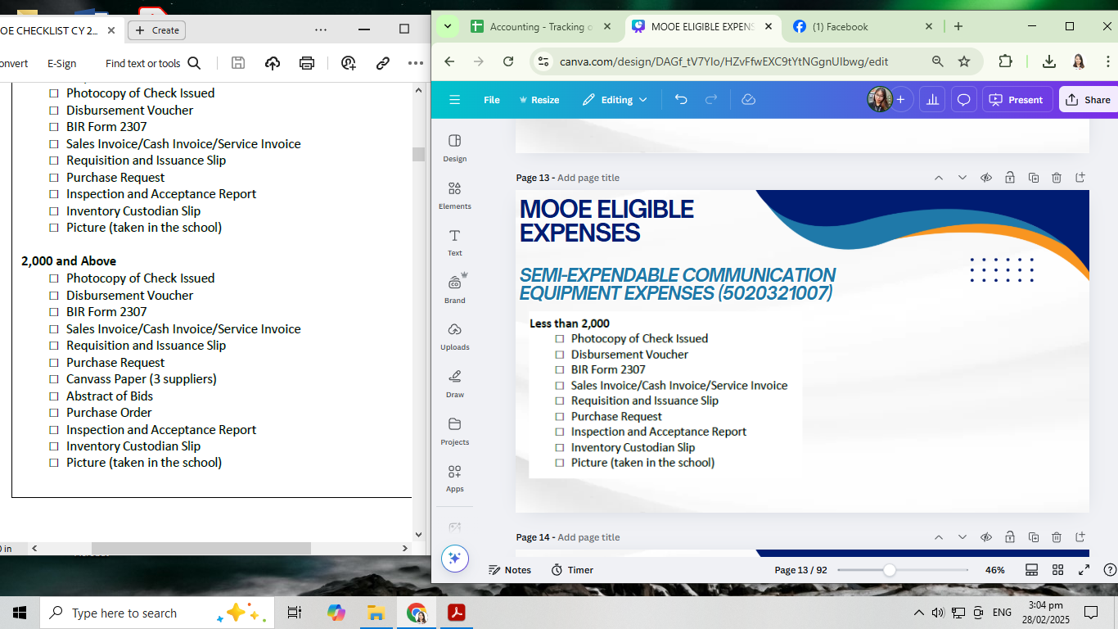
MOOE ELIGIBLE EXPENSES
SEMI-EXPENDABLE COMMUNICATION
EQUIPMENT EXPENSES (5020321007)

Slide 14
MOOE ELIGIBLE EXPENSES
SEMI-EXPENDABLE MEDICAL EQUIPMENT EXPENSES (5020321010)
This account is used to recognize the cost/fair value of the
purchased /acquired medical equipment costing less than
50,000.
It includes thermal scanner, thermometer, automated alcohol and soap dispenser, hands free hand washing equipment and the like for the use in the delivery of medical services.

Slide 15
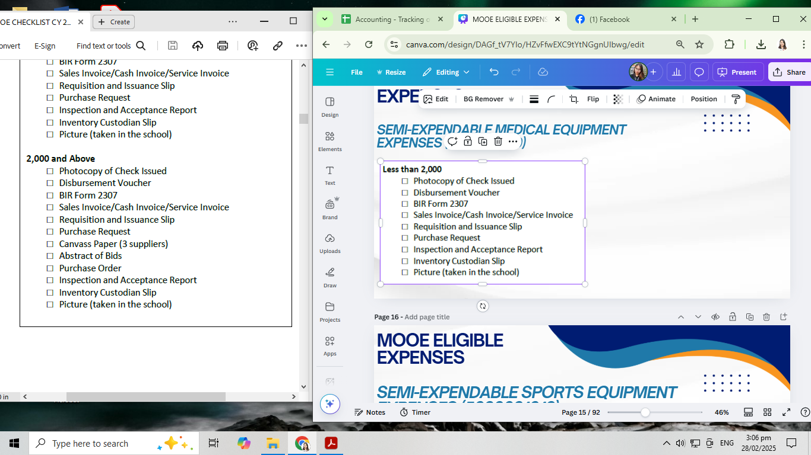
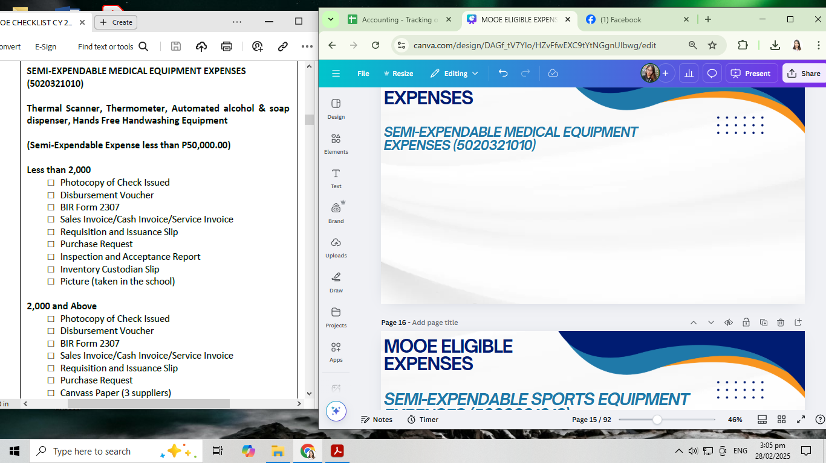
MOOE ELIGIBLE EXPENSES
SEMI-EXPENDABLE MEDICAL EQUIPMENT EXPENSES (5020321010)

Slide 16
MOOE ELIGIBLE EXPENSES
SEMI-EXPENDABLE SPORTS EQUIPMENT EXPENSES (5020321012)
This account is used to recognize the cost/fair value of the purchased /acquired sports equipment costing less than 50,000 for the use in the government's promotion of sports.
It includes Sepak Takraw ball and net, Javelin Throw, Discuss Throw, Shot put, Lawn and table tennis ball/net, Basketball Ring,/Ball/net, Volleyball ball/Net , Chessboard and Badminton

Slide 17
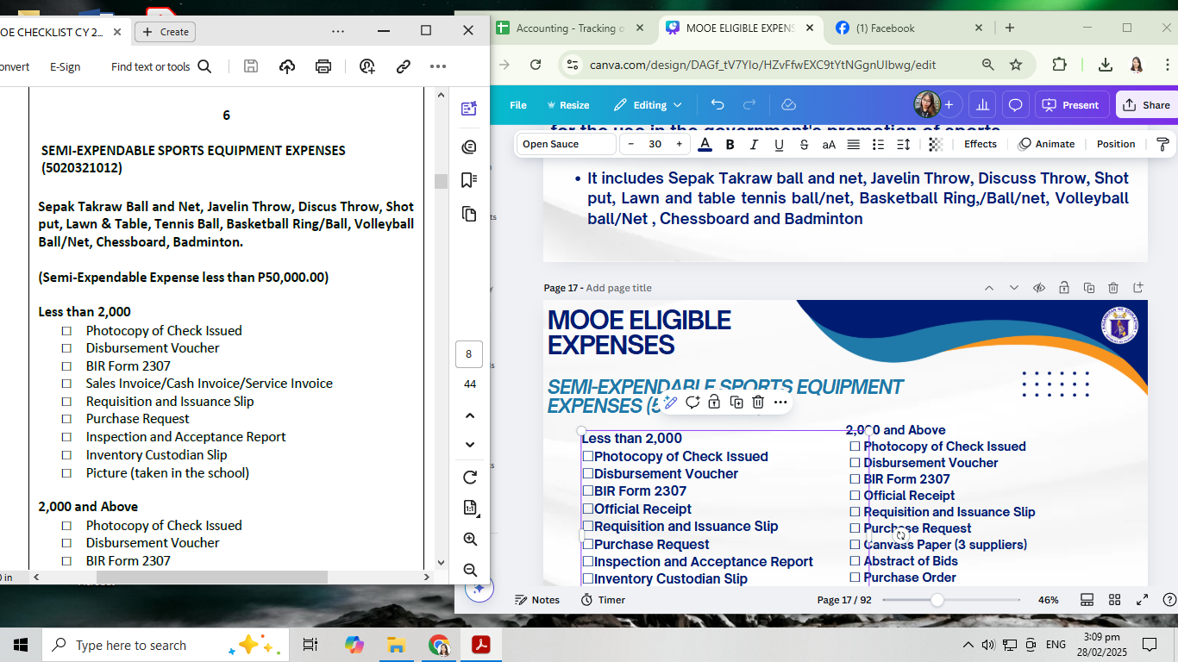
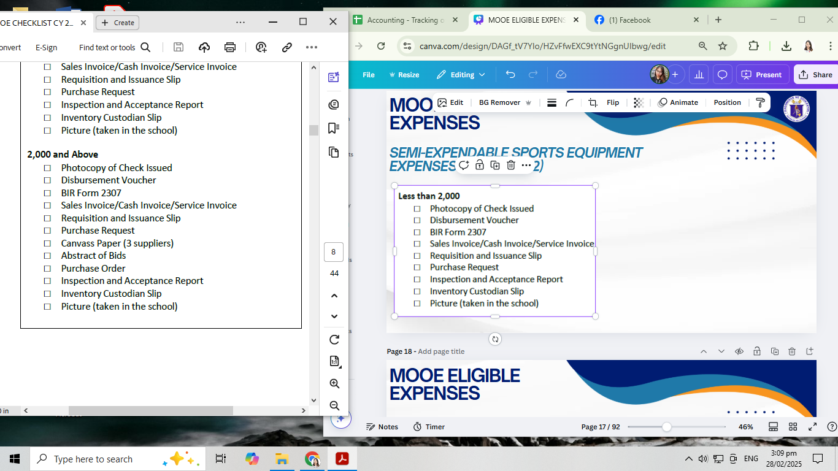
MOOE ELIGIBLE EXPENSES
SEMI-EXPENDABLE SPORTS EQUIPMENT EXPENSES (5020321012)

Slide 18
MOOE ELIGIBLE EXPENSES
SEMI-EXPENDABLE FURNITURE, FIXTURES AND BOOKS EXPENSES (5020322001)
This account is used to recognize the cost/fair value of the purchased / acquired furniture and fixtures costing less than 50,000 for the use in the government operations.
This includes office tables, cabinets and chairs, laboratory and workshop tables, benches, chairs and cabinet

Slide 19
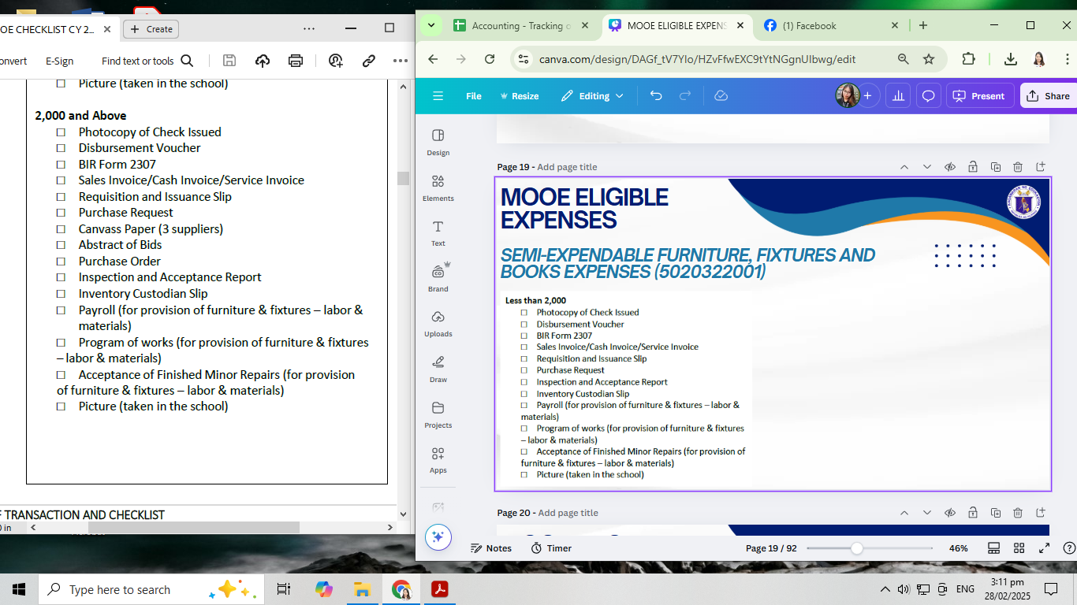
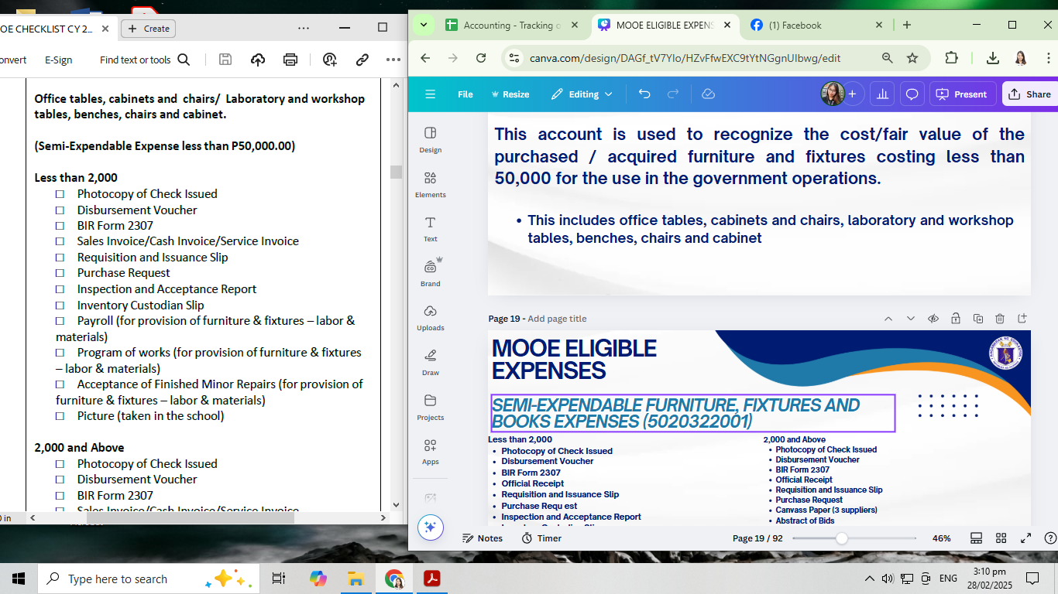
MOOE ELIGIBLE EXPENSES
SEMI-EXPENDABLE FURNITURE, FIXTURES AND BOOKS EXPENSES (5020322001)

Slide 20
MOOE ELIGIBLE EXPENSES
SEMI-EXPENDABLE MACHINERY AND EQUIPMENT EXPENSES - OTHER EQUIPMENT (5020321099)
This account is used to recognize the cost/fair value of the purchased / acquired machinery and equipment costing less than 50,000, not otherwise classified under specific semi-expendable machinery and equipment accounts.
This includes water dispenser, water tank/drum, sewing machine, fire extinguisher, flag, kitchen utensils, comfort room accessories and fixtures, curtains & table cloth, carpets, gas stove, hardware tools,speaker/sound system, TV (for teaching purposes), electric fan and electric motor.

Slide 21
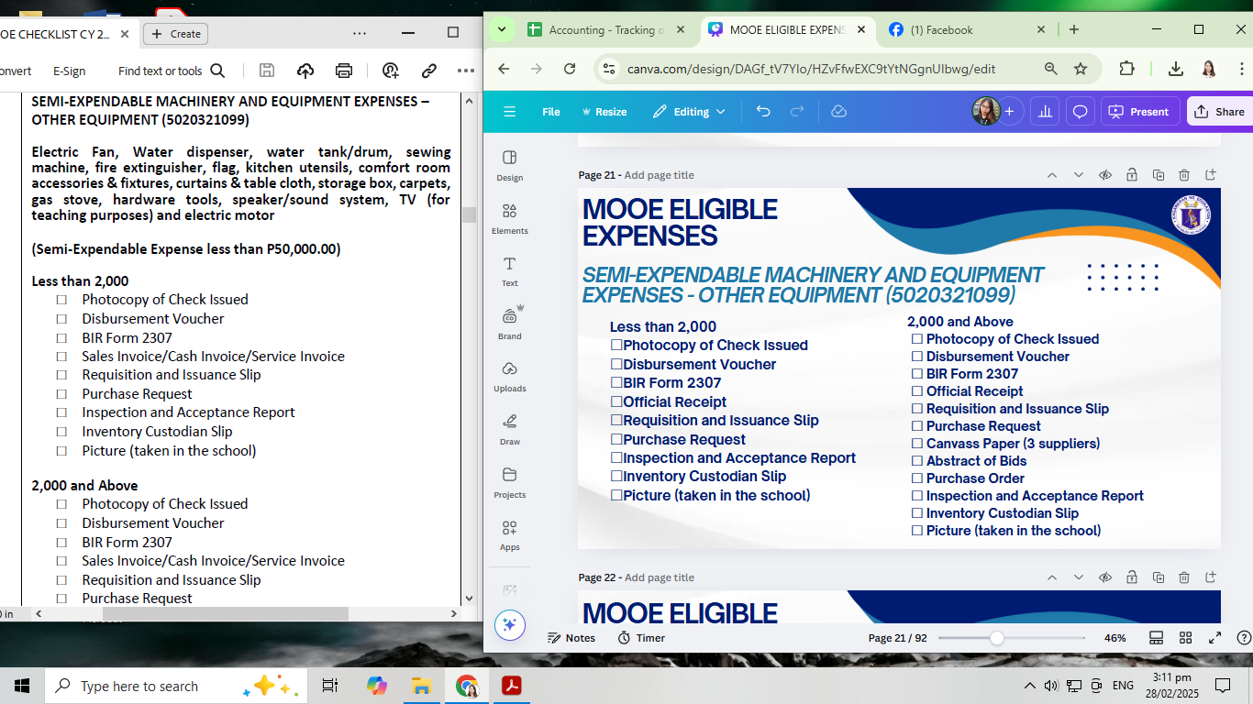
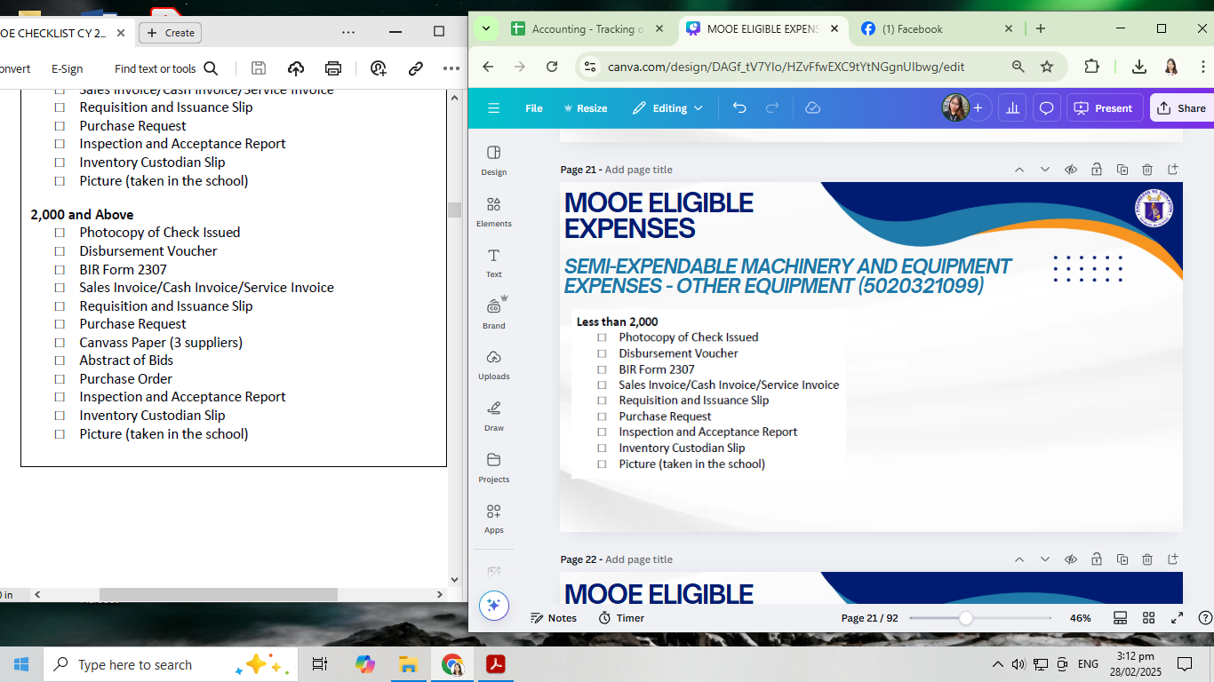
MOOE ELIGIBLE EXPENSES
SEMI-EXPENDABLE MACHINERY AND EQUIPMENT EXPENSES - OTHER EQUIPMENT (5020321099)

Slide 22
MOOE ELIGIBLE EXPENSES
TRAVELING EXPENSES (LOCAL) (5020101000)
This account is used to recognize the costs incurred in the movement/transport of government officers and employees within the country. This includes transportation, travel per diems, ferriage and all other related expenses.

Slide 23
MOOE ELIGIBLE EXPENSES
TRAVELING EXPENSES (LOCAL) (5020101000)
TRAVELING EXPENSES - SEMINAR/MEETING
•Teaching or Non-teaching Staff - within the district, within the division, within the region, outside the region
•School Head – within the district, within the division, within the region, outside the region

Slide 24
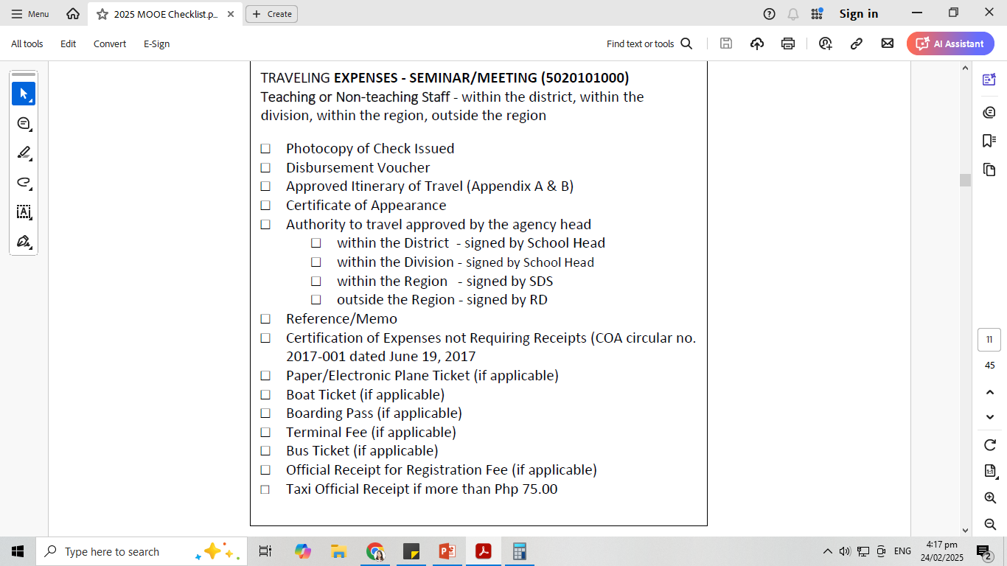
MOOE ELIGIBLE EXPENSES
TRAVELING EXPENSES (LOCAL)
(5020101000)
SEMINAR / MEETING
TEACHING OR
NON TEACHING STAFF

Slide 25
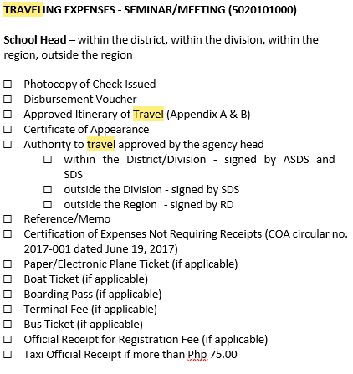
MOOE ELIGIBLE EXPENSES
TRAVELING EXPENSES (LOCAL)
(5020101000)
SEMINAR / MEETING
TEACHING OR
SCHOOL HEAD

Slide 26
MOOE ELIGIBLE EXPENSES
TRAVELING EXPENSES (LOCAL) (5020101000)
TRAVELING EXPENSES - SUBMISSION OF REPORTS
•Teaching or Non-teaching Staff – within the district, within the division, within the region
•School Head – within the district, within the division, within the region

Slide 27
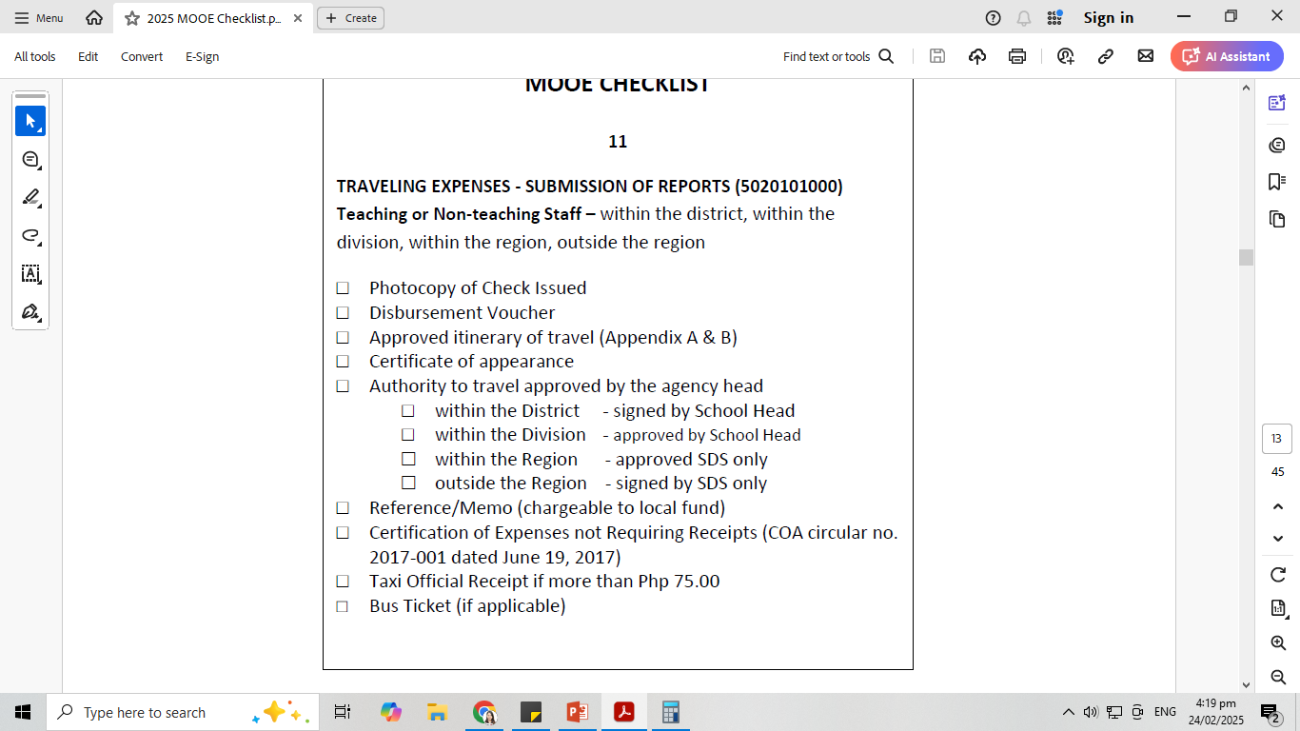
MOOE ELIGIBLE EXPENSES
TRAVELING EXPENSES
(LOCAL)
(5020101000)
SUBMISSION OF REPORTS
TEACHING OR
NON TEACHING STAFF

Slide 28
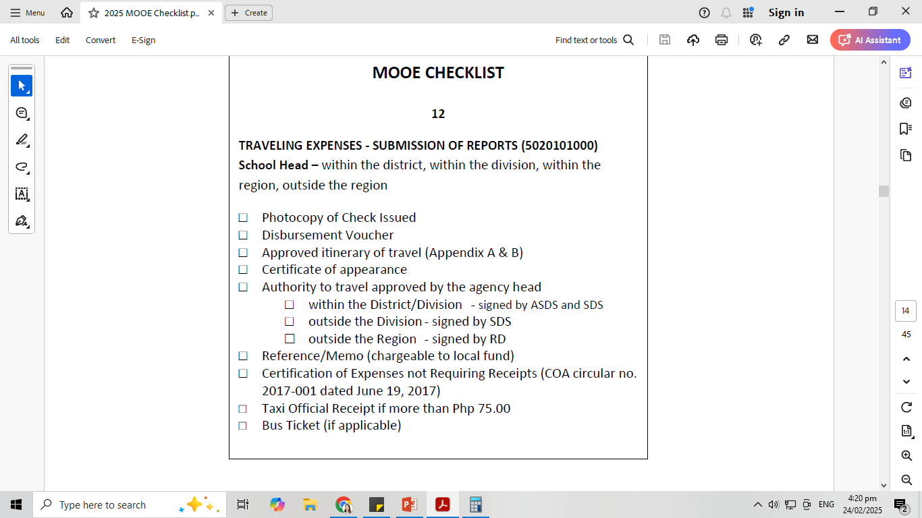
MOOE ELIGIBLE EXPENSES
TRAVELING EXPENSES
(LOCAL)
(5020101000)
SUBMISSION OF REPORTS
SCHOOL HEAD

Slide 29
MOOE ELIGIBLE EXPENSES
TRAVELING EXPENSES (LOCAL) (5020101000)
TRAVELING EXPENSES – ATTENDING CONTEST
•Pupils / Coaches – within the district, within the division, within the region, outside the region

Slide 30
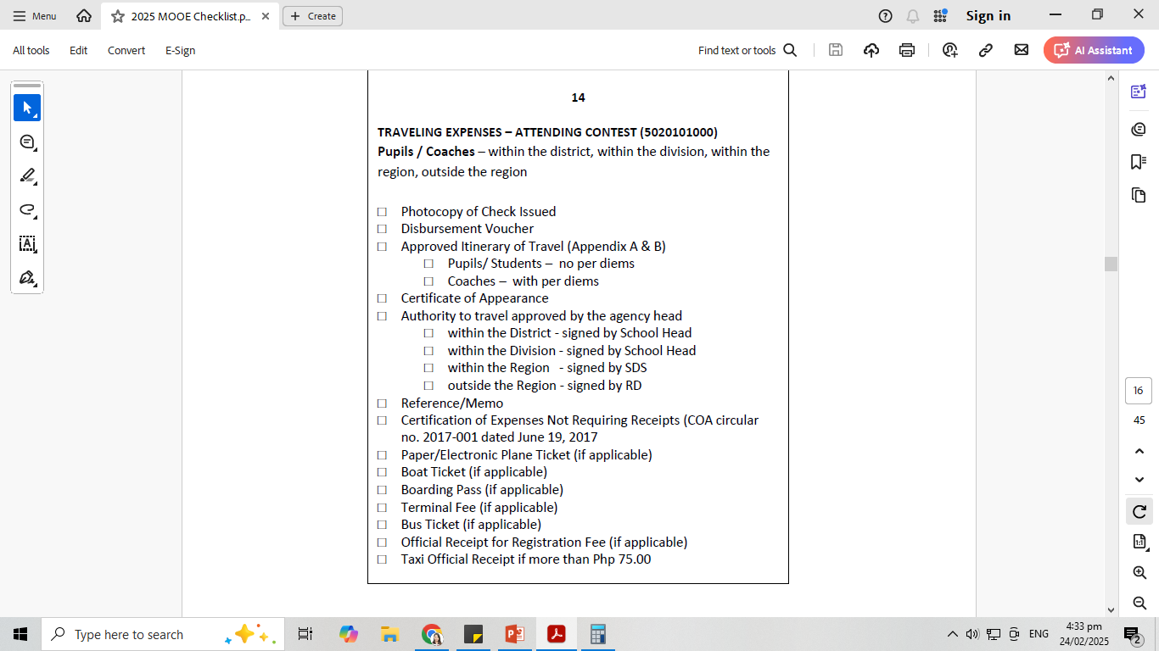
MOOE ELIGIBLE EXPENSES
TRAVELING EXPENSES (LOCAL) (5020101000)
ATTENDING CONTEST

Slide 31
MOOE ELIGIBLE EXPENSES
TRAINING EXPENSES (5020201000)
This account is used to recognize the costs incurred for the participation/attendance in and conduct of trainings, conventions and seminar/workshops.
It includes registration fees, training fees, honoraria of lecturers, cost of handouts, supplies, materials, meals, snacks and all training related expenses.

Slide 32
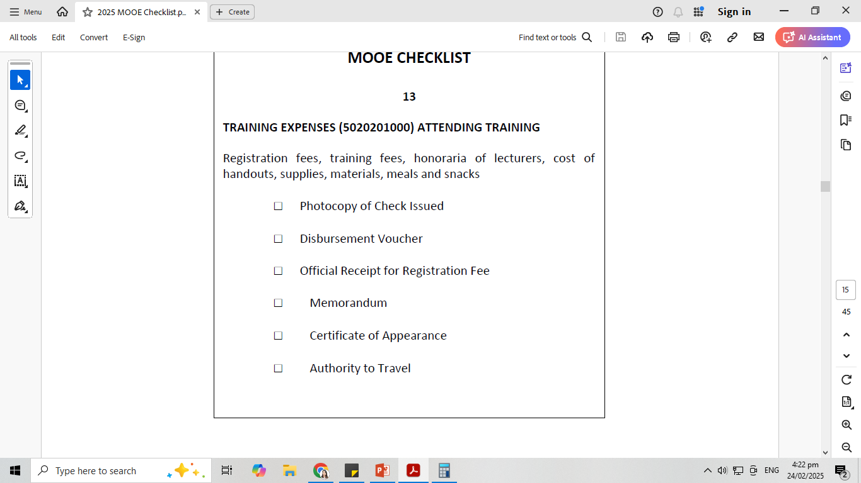
MOOE ELIGIBLE EXPENSES
TRAINING EXPENSES (5020201000)

Slide 33
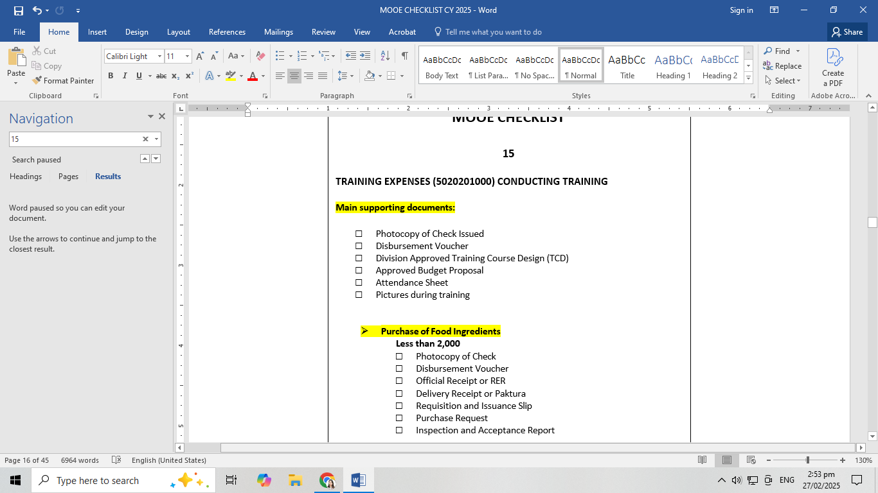
MOOE ELIGIBLE EXPENSES
TRAINING EXPENSES (5020201000) IN CONDUCTING TRAINING

Slide 34
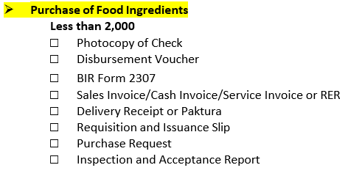
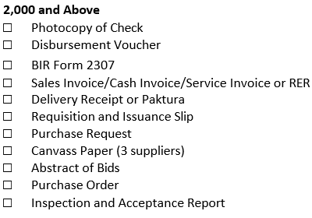
MOOE ELIGIBLE EXPENSES
TRAINING EXPENSES (5020201000)
IN CONDUCTING TRAINING

Slide 35
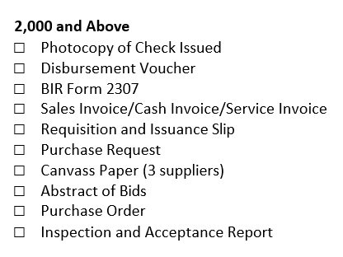
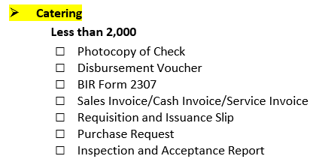
MOOE ELIGIBLE EXPENSES
TRAINING EXPENSES (5020201000)
IN CONDUCTING TRAINING

Slide 36
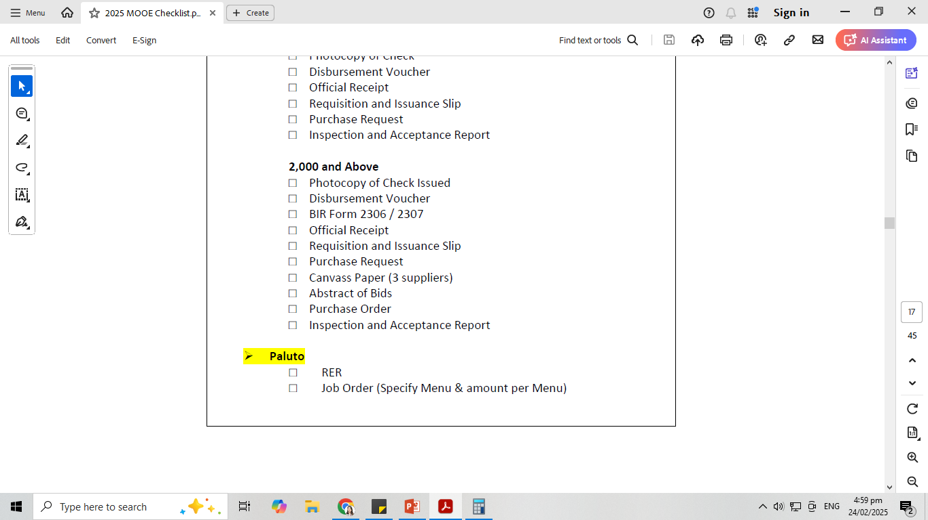
MOOE ELIGIBLE EXPENSES
TRAINING EXPENSES (5020201000)
IN CONDUCTING TRAINING

Slide 37
MOOE ELIGIBLE EXPENSES
OFFICE SUPPLIES EXPENSES (5020301000)
Consumable Items such as Bond Paper, board paper, plastic cover, plastic envelop, Computer Ink, toner for Xerox machine, record book, Folder, envelop, paper fastener, ballpen, pencil, staple wire, paper clips, correction tape, ink, pentel pen, sign pen, scotch tape, push pin, binder clips

Slide 38
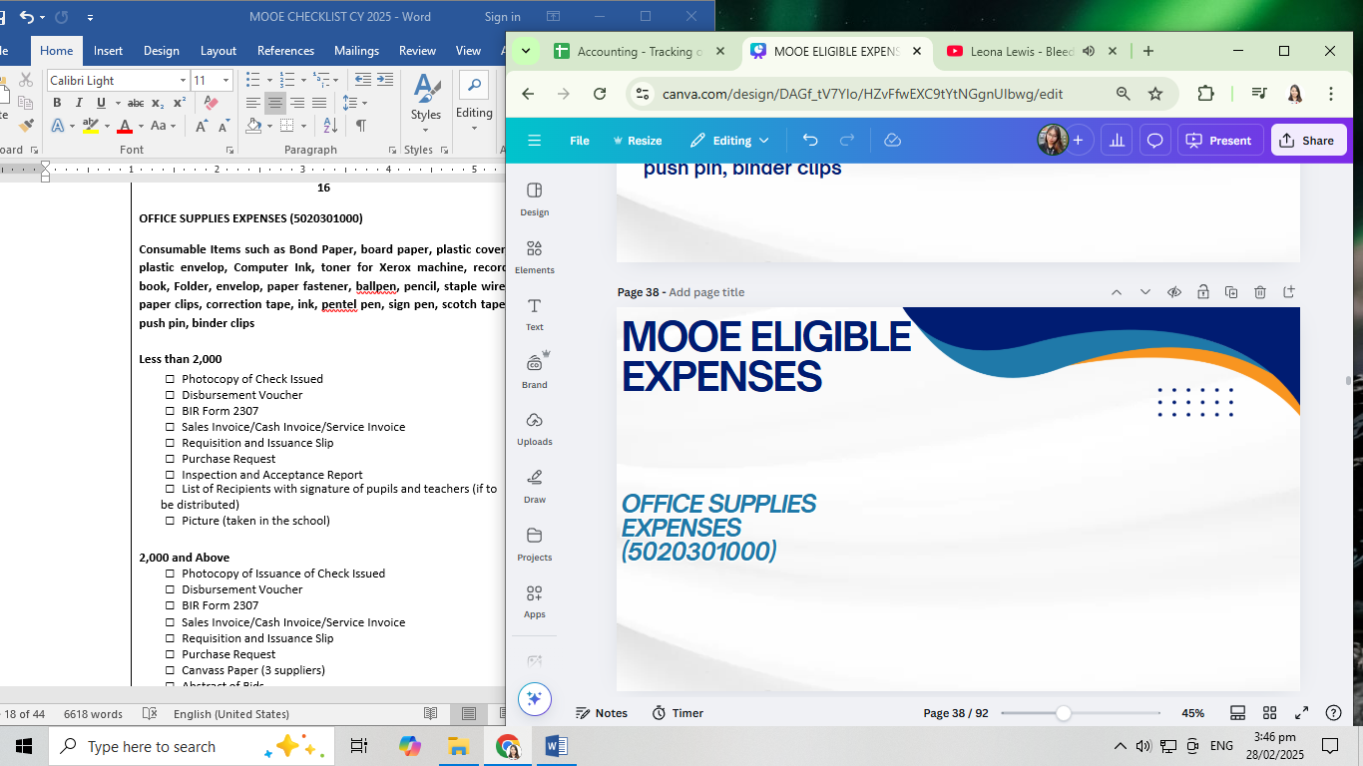
MOOE ELIGIBLE EXPENSES
OFFICE SUPPLIES
EXPENSES
(5020301000)

Slide 39
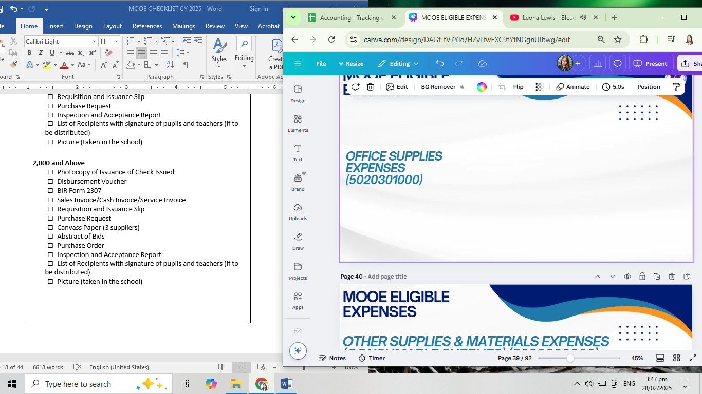
MOOE ELIGIBLE EXPENSES
OFFICE SUPPLIES
EXPENSES
(5020301000)

Slide 40
MOOE ELIGIBLE EXPENSES
OTHER SUPPLIES & MATERIALS EXPENSES (CONSUMABLE SUPPLIES) (5020399000)
This account is used to recognize the costs of supplies issued to end users which are non-inventoriable items and not otherwise classified under the specific inventory expense accounts.
•CLEANING SUPPLIES, AGRICULTURAL AND MARINE SUPPLIES
•HANDWASHING & SANITATION SUPPLIES
•MEDICINES , GROCERIES
•LIQUIFIED PETROLEUM GAS (LPG) – FOR THE H.E.
•PURIFIED DRINKING WATER
•GASOLINE EXPENSES FOR GRASS CUTTING
•TARPAULIN, STREAMER, ID’S OF PUPILS / FORM 138-A
•MEDALS AND RIBBONS FOR RECOGNITION AND GRADUATION RITES
•BULBS/FLUORESCENT LAMP
•EXTENSION CORD

Slide 41
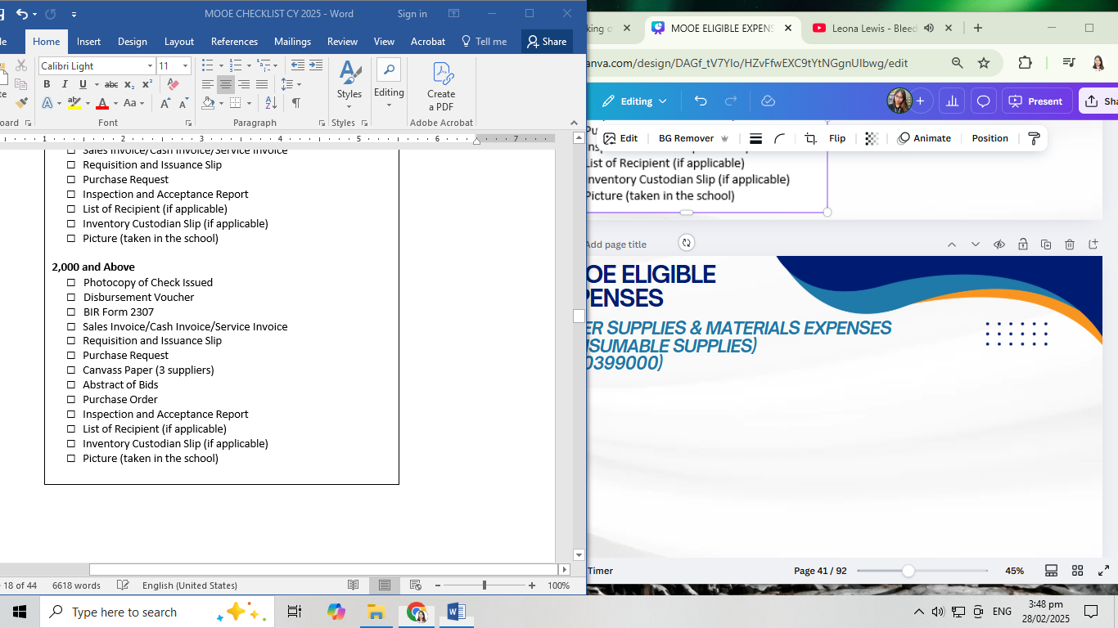
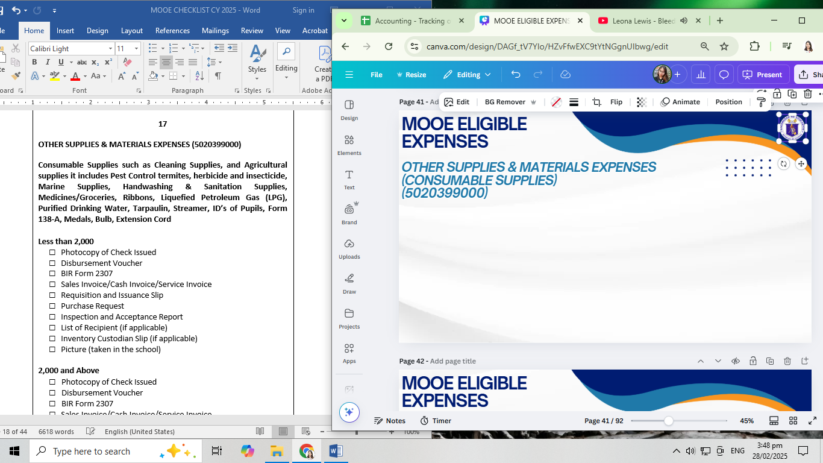
MOOE ELIGIBLE EXPENSES
OTHER SUPPLIES & MATERIALS EXPENSES (CONSUMABLE SUPPLIES)
(5020399000)

Slide 42
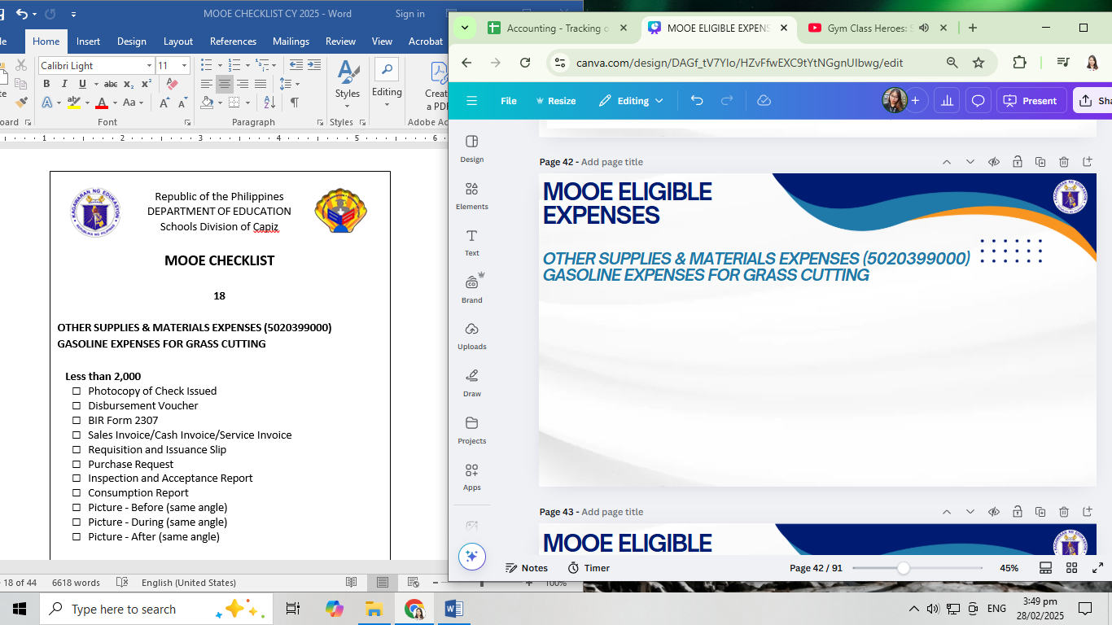
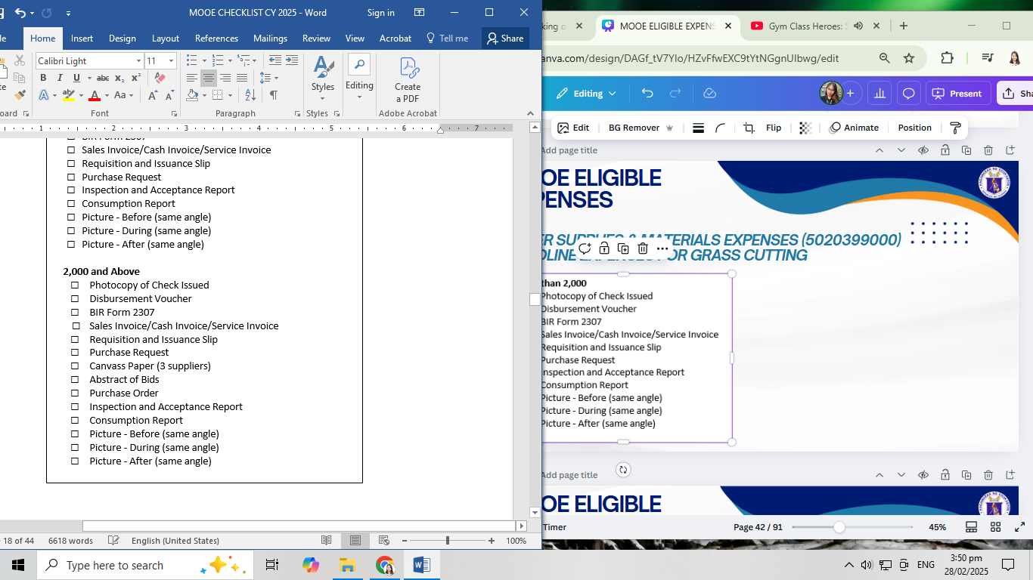
MOOE ELIGIBLE EXPENSES
OTHER SUPPLIES & MATERIALS EXPENSES (5020399000)
GASOLINE EXPENSES FOR GRASS CUTTING

Slide 43
MOOE ELIGIBLE EXPENSES
WATER EXPENSES (5020401000)
This account is used to recognize the cost of water consumed in government operations/projects.
ELECTRICITY EXPENSES (5020402000)
This account is used to recognize the cost of electricity consumed in government operations/projects.

Slide 44
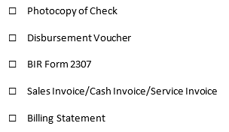
MOOE ELIGIBLE EXPENSES
WATER EXPENSES (5020401000)
ELECTRICITY EXPENSES (5020402000)

Slide 45
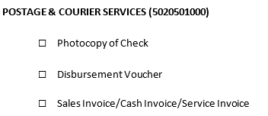
MOOE ELIGIBLE EXPENSES
POSTAGE AND COURIER EXPENSES (5020501000)
This account is used to recognize the cost of delivery/transmission of official messages, mails, documents, recognizes and the like.

Slide 46
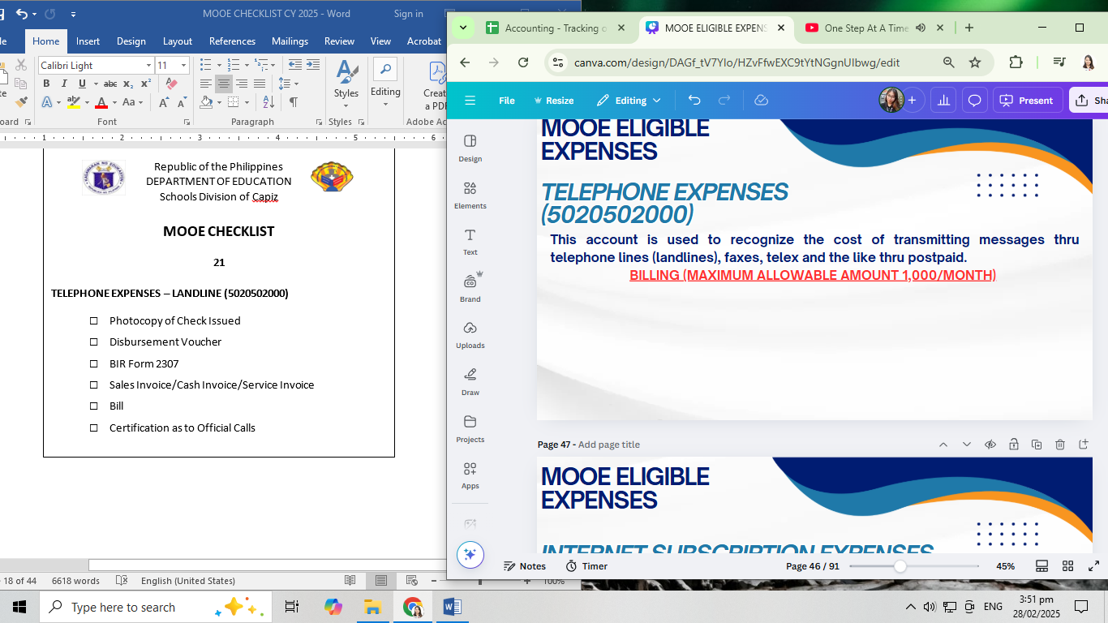
MOOE ELIGIBLE EXPENSES
TELEPHONE EXPENSES (5020502000)
This account is used to recognize the cost of transmitting messages thru telephone lines (landlines), faxes, telex and the like thru postpaid.
BILLING (MAXIMUM ALLOWABLE AMOUNT 1,000/MONTH)

Slide 47
MOOE ELIGIBLE EXPENSES
INTERNET SUBSCRIPTION EXPENSES (502050300)
This account is used to recognize the cost of using internet services in government operations.
•POSTPAID (MAXIMUM ALLOWABLE AMOUNT 4,000/MONTH)
•PREPAID (MAXIMUM ALLOWABLE AMOUNT 1,000/MONTH)

Slide 48
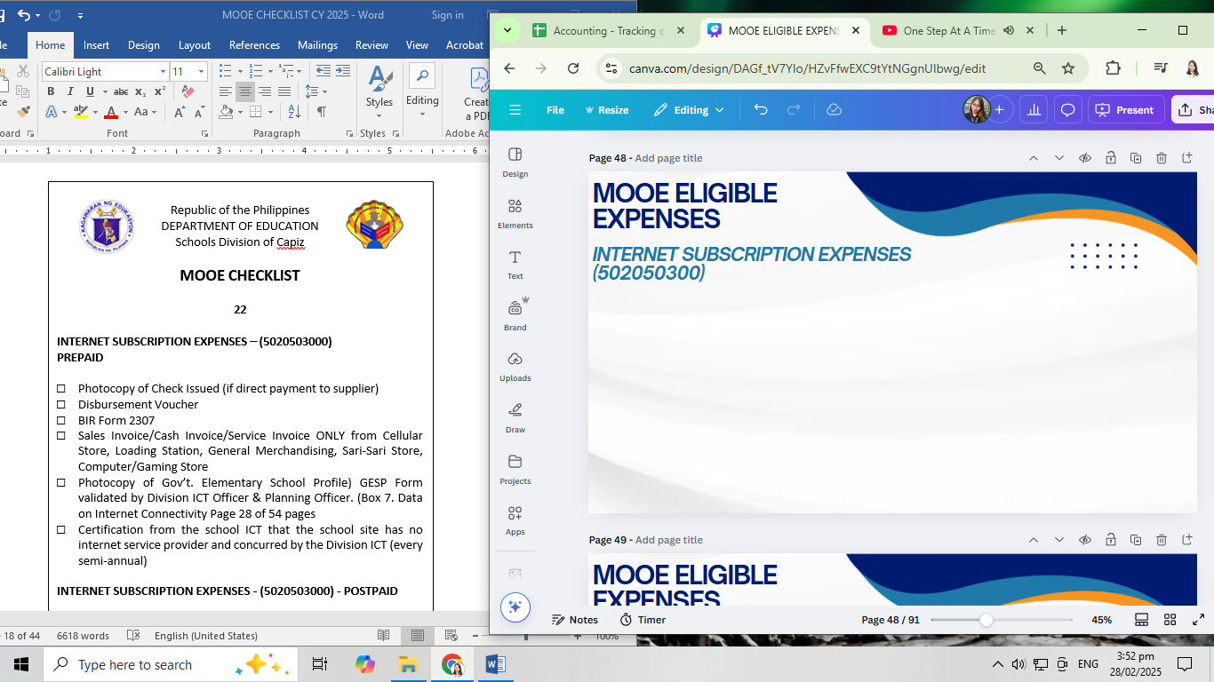
MOOE ELIGIBLE EXPENSES
INTERNET SUBSCRIPTION EXPENSES (502050300)

Slide 49
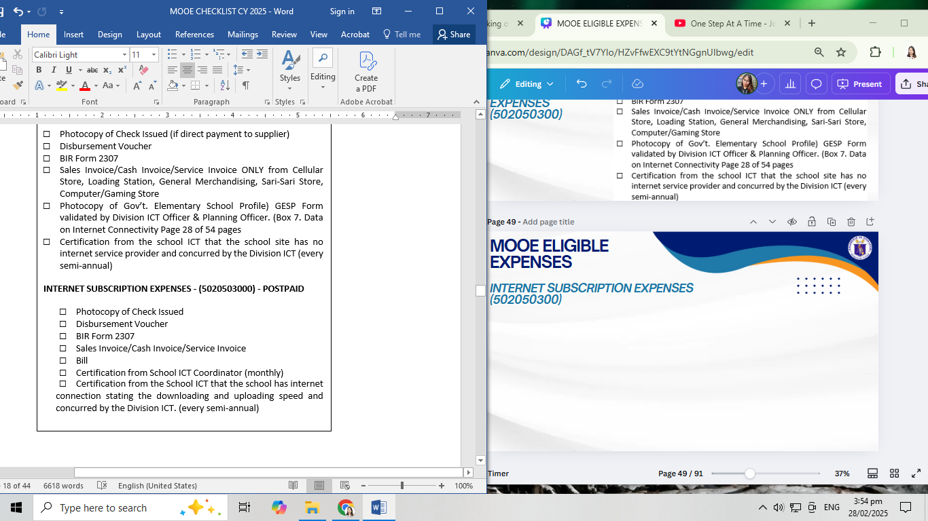
MOOE ELIGIBLE EXPENSES
INTERNET SUBSCRIPTION EXPENSES (502050300)

Slide 50
MOOE ELIGIBLE EXPENSES
JANITORIAL SERVICES
(UTILITY WORKER) (5021202000)
This account is used to recognize the cost of janitorial services contracted by the government.
SECURITY SERVICES (5021203000)
This account is used to recognize the cost of security services contracted by the government.

Slide 51
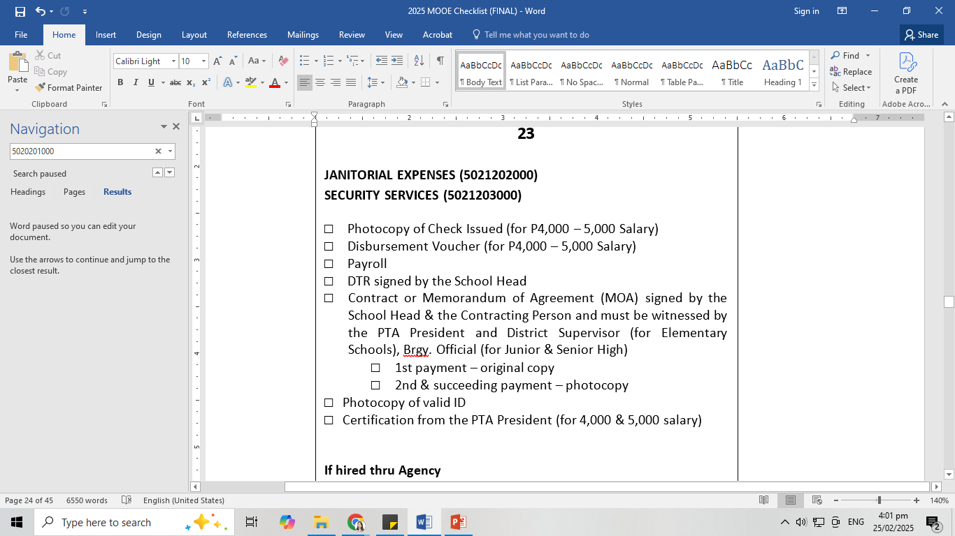
MOOE ELIGIBLE EXPENSES
JANITORIAL SERVICES (UTILITY WORKER) (5021202000)
SECURITY SERVICES (5021203000)

Slide 52
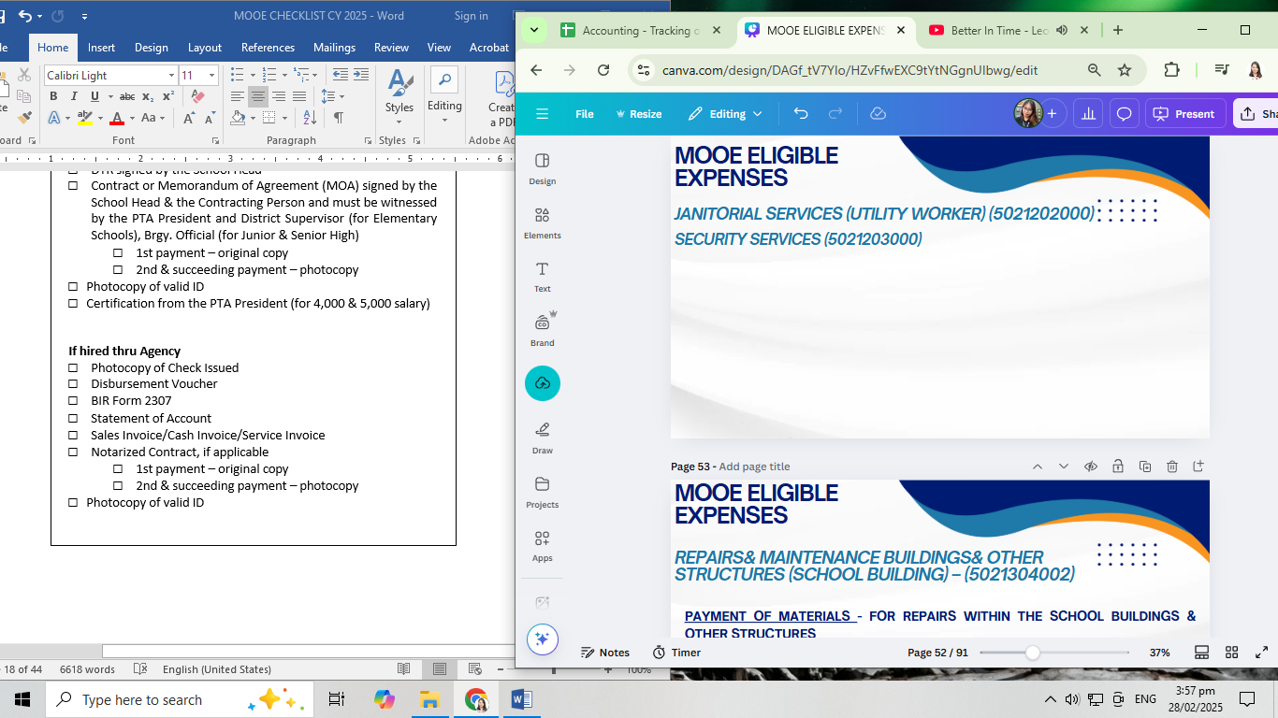
MOOE ELIGIBLE EXPENSES
JANITORIAL SERVICES (UTILITY WORKER) (5021202000)
SECURITY SERVICES (5021203000)

Slide 53
MOOE ELIGIBLE EXPENSES
REPAIRS& MAINTENANCE BUILDINGS& OTHER STRUCTURES (SCHOOL BUILDING) – (5021304002)
PAYMENT OF MATERIALS - FOR REPAIRS WITHIN THE SCHOOL BUILDINGS & OTHER STRUCTURES
Repainting / Provisions of CR, Window, Ceiling, Door, Roofs, Floor, Walls, Gutter / Office of the School Head/ Computer Room / Installation of Electrical Wirings/ Water Connection, and other repairs and maintenance expenses related to school buildings and other structures.

Slide 54
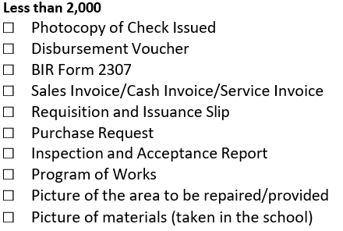
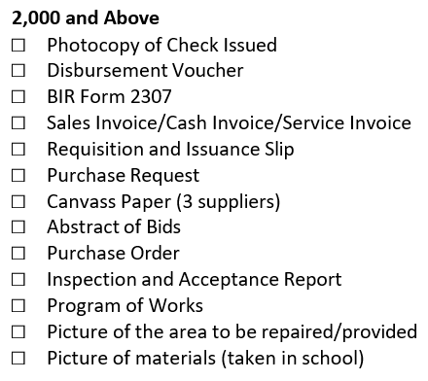
MOOE ELIGIBLE EXPENSES
REPAIRS & MAINTENANCE - BUILDINGS AND OTHER STRUCTURES (SCHOOL BUILDING) – (5021304002)

Slide 55
MOOE ELIGIBLE EXPENSES
REPAIRS & MAINTENANCE - BUILDINGS & OTHER STRUCTURES (SCHOOL BUILDING) – (5021304002)
PAYMENT OF LABOR COST - FOR REPAIRS WITHIN SCHOOL BUILDINGS AND OTHER STRUCTURES.
Repainting / Provisions of CR, Window, Ceiling, Door, Roofs, Floor, Walls, Gutter/ Office of the School Head/ Computer Room / Installation of Electrical Wirings/ Water Connection, and other repairs and maintenance expenses related to school buildings and other structures.

Slide 56
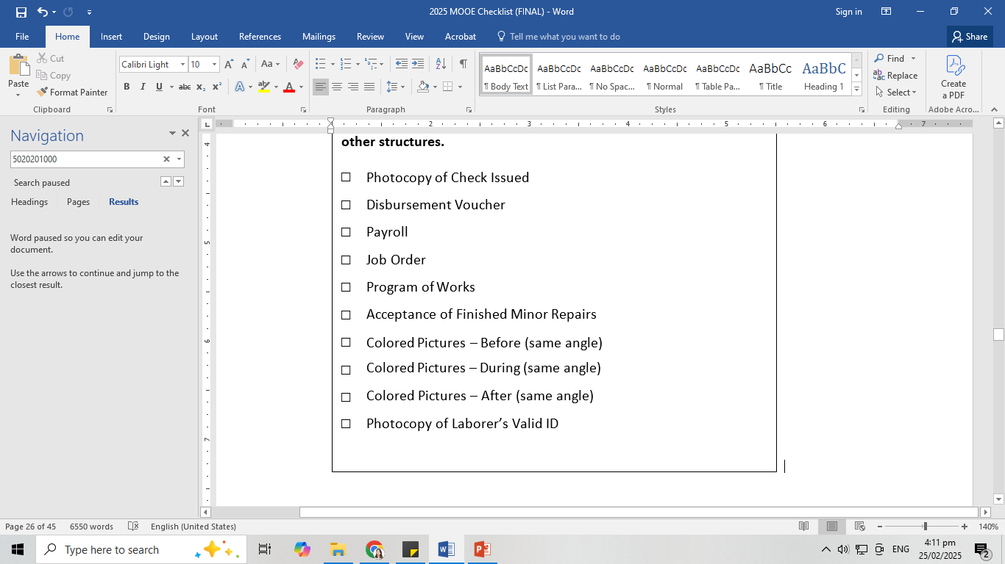
MOOE ELIGIBLE EXPENSES
REPAIRS & MAINTENANCE - BUILDINGS & OTHER STRUCTURES (SCHOOL BUILDING) – (5021304002)

Slide 57
MOOE ELIGIBLE EXPENSES
REPAIRS & MAINTENANCE – SEMI-EXPENDABLE MACHINERY AND EQUIPMENT - (ICT EQUIPMENT) (5021321003)
Repair/Reformat of Laptop, Desktop Computer, DLP, Laptop Charger, Printer, Photocopier, CCTV and Scanner.
REPAIRS & MAINTENANCE – SEMI-EXPENDABLE MACHINERY AND EQUIPMENT - AGRICULTURAL & FORESTRY EQUIPMENT
(5021321004
Repair of Grass Cutter

Slide 58
MOOE ELIGIBLE EXPENSES
REPAIRS & MAINTENANCE – SEMI-EXPENDABLE - FURNITURE, FIXTURES AND BOOKS (5021322001)
Repair of office tables, cabinets and chairs, laboratory and workshop tables, benches, chairs and cabinet
REPAIRS & MAINTENANCE – SEMI-EXPENDABLE MACHINERY AND EQUIPMENT- OTHER MACHINERY AND EQUIPMENT (5021321099)
Repair of sewing machine, speaker/sound system, TV, electric fan and electric motor.

Slide 59
MOOE ELIGIBLE EXPENSES
REPAIRS & MAINTENANCE
SEMI-EXPENDABLE MACHINERY AND EQUIPMENT ICT EQUIPMENT (5021321003)
SEMI-EXPENDABLE MACHINERY AND EQUIPMENT - AGRICULTURAL & FORESTRY EQUIPMENT (5021321004)
SEMI-EXPENDABLE - FURNITURE, FIXTURES AND BOOKS (5021322001)
SEMI-EXPENDABLE MACHINERY AND EQUIPMENT- OTHER MACHINERY AND EQUIPMENT (5021321099)
□Photocopy of Check Issued (if applicable)
□Disbursement Voucher
□Payroll (if applicable)
□BIR Form 2307 (if applicable)
□Sales Invoice/Cash Invoice/Service Invoice or RER
(if school is hardship post for ICT Equipment)
□Equipment Diagnostic Report (for ICT Equipment)
□Job Order
□Inventory Custodian Slip/ Acknowledgement Receipt of Equipment (to verify that the equipment is property of the school)
□Program of Works (for repair of furniture & fixtures)
□Acceptance of Finished Minor Repairs
(for repair of furniture & fixtures)
□Pictures– Before (taken in the school)
(for repair of furniture & fixtures)
□Pictures– During (taken in the school)
(for repair of furniture &
fixtures)
□Pictures– After (taken in the school) (for repair of furniture &
fixtures)
□Photocopy of Laborer’s Valid ID

Slide 60
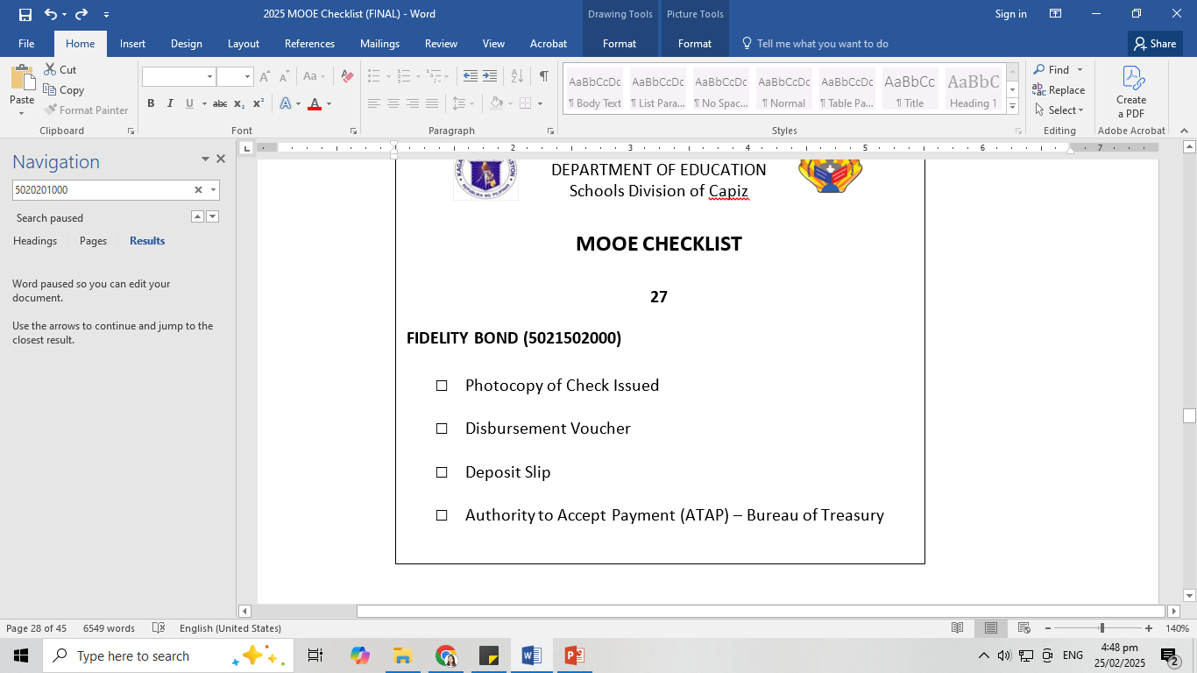
MOOE ELIGIBLE EXPENSES
FIDELITY BOND PREMIUMS (502150200)
This account is used to recognize the amount of premiums paid by the agency for the fidelity bonds of the accountable officers.

Slide 61
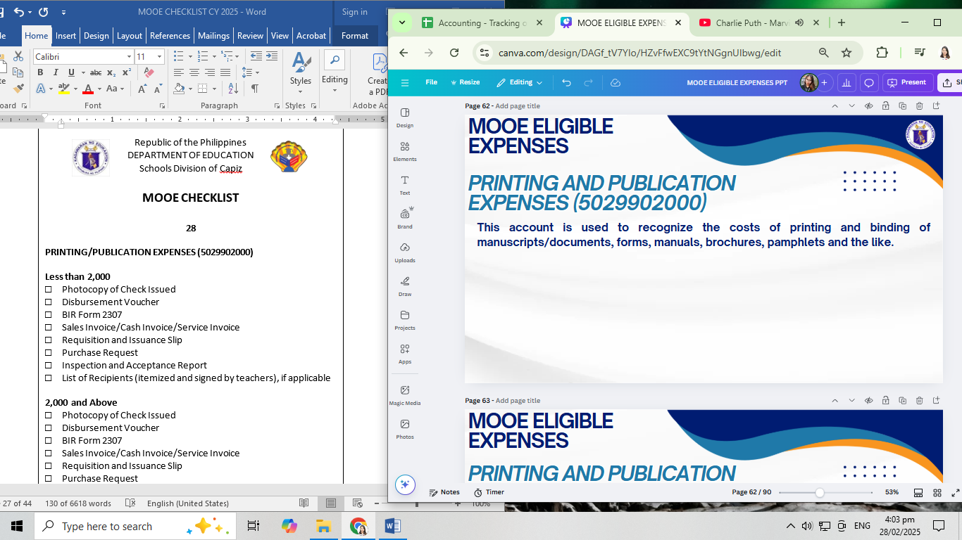
MOOE ELIGIBLE EXPENSES
PRINTING AND PUBLICATION EXPENSES (5029902000)
This account is used to recognize the costs of printing and binding of manuscripts/documents, forms, manuals, brochures, pamphlets and the like.

Slide 62
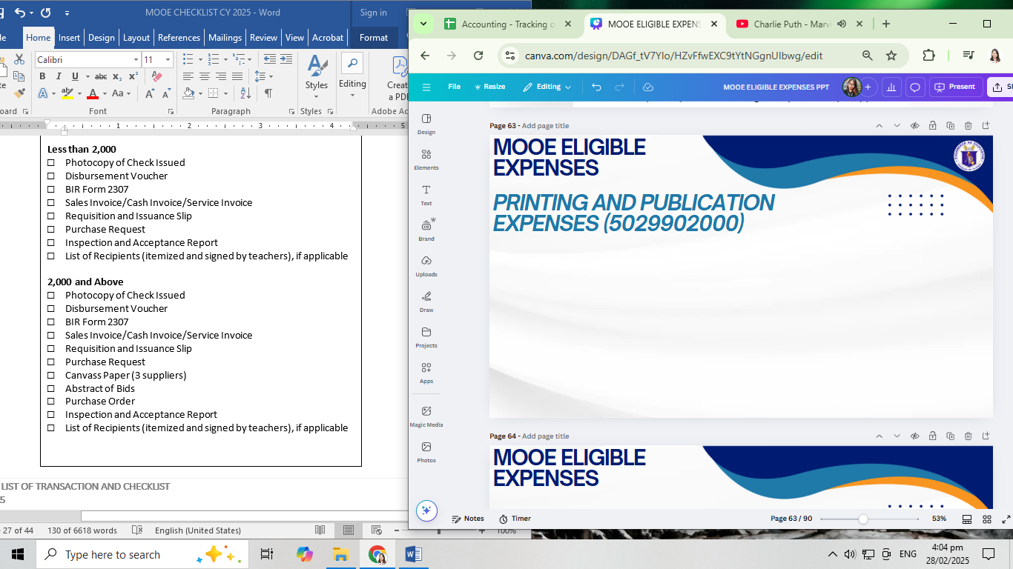
MOOE ELIGIBLE EXPENSES
PRINTING AND PUBLICATION EXPENSES (5029902000)

Slide 63
MOOE ELIGIBLE EXPENSES
OTHER MOOE (5029999099)
PAYMENT OF MATERIALS - FOR REPAIRS OF SCHOOL FACILITIES OUTSIDE OF SCHOOL BUILDINGS AND OTHER STRUCTURES
Repairs/Provision of: Stage, Flagpole, Makeshift Classroom, Makeshift Office of the School Head, Flower Boxes, Nursery, Path walk/Foot walk, Subject Park, School Signage, Water & Sanitation Facilities, Landscaping, Storage Room, Kitchen, H.E or Feeding Room, Canteen, Fence, Gate, Shed, Canopy, Transparency Board and Bulletin Board

Slide 64
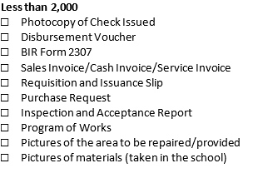
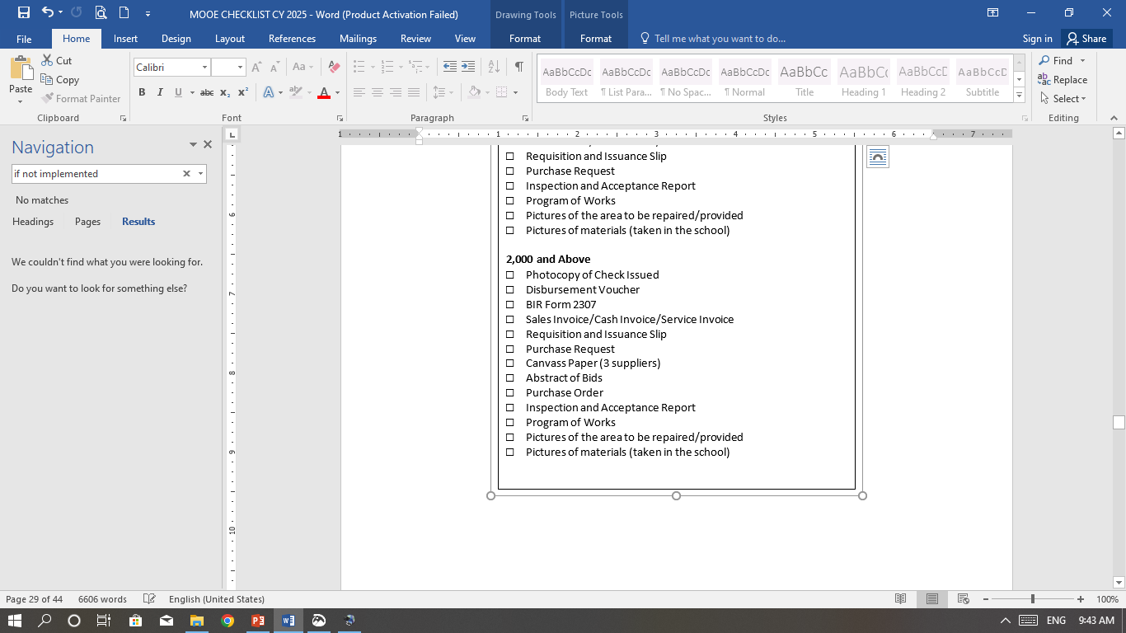
MOOE ELIGIBLE EXPENSES
OTHER MOOE (5029999099)
PAYMENT OF MATERIALS - FOR REPAIRS OF SCHOOL FACILITIES OUTSIDE OF SCHOOL BUILDINGS AND OTHER STRUCTURE

Slide 65
MOOE ELIGIBLE EXPENSES
OTHER MOOE (5029999099)
PAYMENT OF LABOR COST – FOR REPAIRS OF SCHOOL FACILITIES OUTSIDE OF SCHOOL BUILDINGS AND OTHER STRUCTURES
Repairs/Provision of: Stage, Flagpole, Makeshift Classroom, Makeshift Office of the School Head, Flower Boxes, Nursery, Path walk/Foot walk, Subject Park, School Signage, Water & Sanitation Facilities, Landscaping, Storage Room, Kitchen, H.E or Feeding Room, Canteen, Fence, Gate, Shed, Canopy, Transparency Board and Bulletin Board

Slide 66
MOOE ELIGIBLE EXPENSES
OTHER MOOE (5029999099)
PAYMENT OF LABOR COST – FOR REPAIRS OF SCHOOL FACILITIES OUTSIDE OF SCHOOL BUILDINGS AND OTHER STRUCTURES
□Photocopy of Check Issued
□Disbursement Voucher
□Payroll
□Job Order
□Program of Works
□Acceptance of Finished Minor Repairs
□Colored Pictures – Before(same angle)
□Colored Pictures – During(same angle)
□Colored Pictures – After (same angle)
□Photocopy of Laborer’s ID

Slide 67
MOOE ELIGIBLE EXPENSES
OTHER MOOE (5029999099)
PAKYAW (PACKAGE-MATERIALS & LABOR) - FOR REPAIRS OF SCHOOL FACILITIES OUTSIDE OF SCHOOL BUILDINGS AND OTHER STRUCTURES.
REPAIR/PROVISION OF CONCRETE FENCE/GATE AND CONCRETE TRASH CAN FOR WASTE SEGREGATION AND OTHER STEEL WORKS OUTSIDE THE SCHOOL BUILDING.
REPAIRS & MAINTENANCE BUILDINGS & OTHER STRUCTURES (SCHOOL BUILDING) – (5021304002)
PAKYAW (PACKAGE – MATERIALS & LABOR) FOR REPAIRS WITHIN THE SCHOOL BUILDINGS & OTHER STRUCTURE.
REPAIR/PROVISION OF GRILLS WINDOWS& DOORS AND OTHER STEELWORKS WITHIN THE SCHOOL BUILDING.

Slide 68
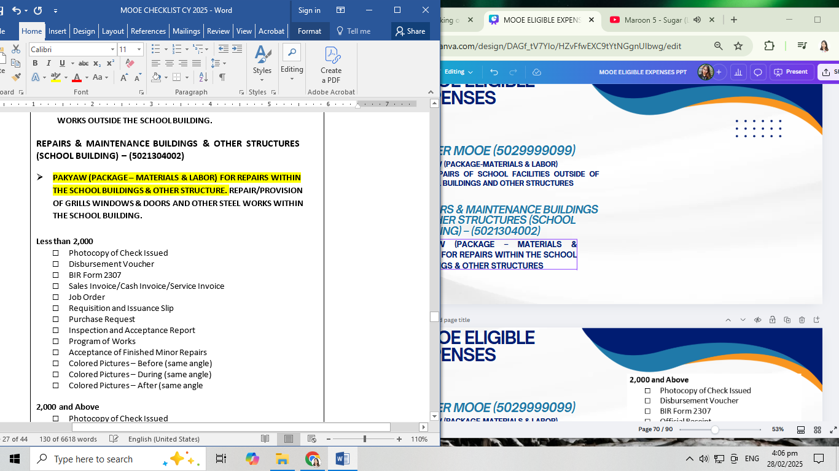
MOOE ELIGIBLE EXPENSES
OTHER MOOE (5029999099)
PAKYAW (PACKAGE-MATERIALS & LABOR)
FOR REPAIRS OF SCHOOL FACILITIES OUTSIDE OF SCHOOL BUILDINGS AND OTHER STRUCTURES
REPAIRS & MAINTENANCE BUILDINGS & OTHER STRUCTURES (SCHOOL BUILDING) – (5021304002)
PAKYAW (PACKAGE – MATERIALS & LABOR) FOR REPAIRS WITHIN THE SCHOOL BUILDINGS & OTHER STRUCTURES

Slide 69

MOOE ELIGIBLE EXPENSES
OTHER MOOE (5029999099)
PAKYAW (PACKAGE-MATERIALS & LABOR)
FOR REPAIRS OF SCHOOL FACILITIES OUTSIDE OF SCHOOL BUILDINGS AND OTHER STRUCTURES
REPAIRS & MAINTENANCE BUILDINGS & OTHER STRUCTURES (SCHOOL BUILDING) – (5021304002)
PAKYAW (PACKAGE – MATERIALS & LABOR) FOR REPAIRS WITHIN THE SCHOOL BUILDINGS & OTHER STRUCTURES

Slide 70

MOOE ELIGIBLE EXPENSES
OTHER MOOE (5029999099)
PAYMENTOF LABOR COST – FOR CONDEMNATION/DEMOLITION

Slide 71


MOOE ELIGIBLE EXPENSES
OTHER MOOE (5029999099)
PURCHASE OF LUMBER

Slide 72


MOOE ELIGIBLE EXPENSES
OTHER MOOE (5029999099)
PURCHASE OF PU-OD / BAMBOO

Slide 73

MOOE ELIGIBLE EXPENSES
OTHER MOOE (5029999099)
CUTTING OF LUMBER (within school premises)

Slide 74

MOOE ELIGIBLE EXPENSES
OTHER MOOE (5029999099)
HAULING OF MATERIALS

Slide 75

MOOE ELIGIBLE EXPENSES
OTHER MOOE (5029999099)
TRANSPORTATION EXPENSE(immersion of students)

Slide 76

MOOE ELIGIBLE EXPENSES
OTHER MOOE (5029999099)
TRANSPORTATION EXPENSE (Sports Meet)

Slide 77

MOOE ELIGIBLE EXPENSES
OTHER MOOE (5029999099)
RENTAL OF SOUND/EQUIPMENT

Slide 78

MOOE ELIGIBLE EXPENSES
OTHER MOOE (5029999099)
PROVISION OF DEEP WELL OR INSTALLATION OF JETMATIC PUMP

Slide 79

MOOE ELIGIBLE EXPENSES
OTHER MOOE (5029999099)
RELOCATION EXPENSE

Slide 80

MOOE ELIGIBLE EXPENSES
OTHER MOOE (5029999099)
SURVEY EXPENSE
(for subdivision plan)

Slide 81


MOOE ELIGIBLE EXPENSES
OTHER MOOE (5029999099)
FOOD PURCHASE OF INGREDIENTS

Slide 82


MOOE ELIGIBLE EXPENSES
OTHER MOOE (5029999099)
FOOD – CATERING

Slide 83

MOOE ELIGIBLE EXPENSES
OTHER MOOE (5029999099)

Slide 84

MOOE ELIGIBLE EXPENSES
OTHER MOOE (5029999099)

Slide 85

MOOE ELIGIBLE EXPENSES
OTHER MOOE (5029999099)

Slide 86

MOOE ELIGIBLE EXPENSES
OTHER MOOE (5029999099)

Slide 87

MOOE ELIGIBLE EXPENSES
OTHER MOOE (5029999099)

Slide 88
MOOE ELIGIBLE EXPENSES
OTHER MOOE (5029999099)
Daily Wage – Labor for Clearing of Trees, Laundry, Disinfecting of School Classroom, Spraying of Pesticides, Digging of Holes for waste disposal, Grass Cutting, Weeding, Gardening and Landscaping.
5 days is allowed in a month maximum rate is only P300/day or 1,500/month.

Slide 89
MOOE ELIGIBLE EXPENSES
OTHER MOOE (5029999099)
Daily Wage – Labor
□Photocopy of Check Issued
□Disbursement Voucher
□Payroll
□Job Order
□Picture (before)
□Picture (during)
□Picture (after)
□Photocopy of Laborer’s Valid ID

Slide 90
THANK YOU
FOR LISTENING

